Slide 1






Introduction
to
Data Structures

Slide 2





Definition
 Data: Collection of raw facts.
 Data structure is representation of the logical relationship existing between individual elements of data.
 Data structure is a specialized format for organizing and storing data in memory that considers not only the elements stored but also their relationship to each other.
2

Slide 3

Introduction
 Data structure affects the design of both structural & functional aspects of a program. Program=algorithm + Data Structure
 You know that a algorithm is a step by step procedure to solve a particular function.

Slide 4

Classification of Data Structure
 Data structure are normally divided into two broad categories:
Primitive Data Structure
Non-Primitive Data Structure
4

Slide 5

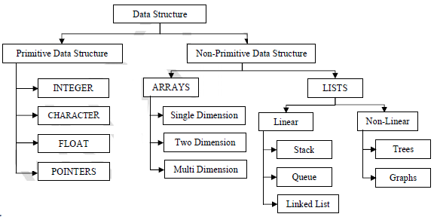
Classification of Data Structure
5

Slide 6

Primitive Data Structure
 There are basic structures and directly operated upon by the machine instructions.
 Data structures that are directly operated upon the machine-level instructions are known as primitive data structures.
 Integer, Floating-point number, Character constants, string constants, pointers etc, fall in this category.

Slide 7



Primitive Data Structure
 The most commonly used operation on data structure are broadly categorized into following types:
Create
Selection
Updating
Destroy or Delete
7

Slide 8

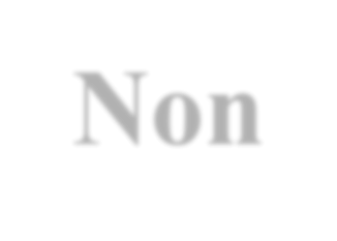


Non-Primitive Data Structure
 There are more sophisticated data structures.
 The Data structures that are derived from the primitive data structures are called Non-primitive data structure.
 The non-primitive data structures emphasize on structuring of a group of homogeneous (same type) or heterogeneous (different type) data items.
8

Slide 9


Non-Primitive Data Structure
Linear Data structures:
Linear Data structures are kind of data structure that has homogeneous elements.
The data structure in which elements are in a sequence and form a liner series.
Linear data structures are very easy to implement, since the memory of the computer is also organized in a linear fashion.
Some commonly used linear data structures are Stack, Queue and Linked Lists.
Non-Linear Data structures:
A Non-Linear Data structures is a data structure in which data item is connected to several other data items.
Non-Linear data structure may exhibit either a hierarchical relationship or parent child relationship.

Slide 10
The data elements are not arranged in a sequential structure.
The different non-linear data structures are trees and graphs.
9

Slide 11
Non-Primitive Data Structure
 The most commonly used operation on data structure are broadly categorized into following types:
Traversal
Insertion
Selection
Searching
Sorting
Merging
Destroy or Delete

Slide 12

Different between them
 A primitive data structure is generally a basic structure that is usually built into the language, such as an integer, a float.
 A non-primitive data structure is built out of primitive data structures linked together in meaningful ways, such as a or a linked-list, binary search tree, AVL Tree, graph etc.

Slide 13



Description of various Data Structures : Arrays
 An array is defined as a set of finite number of homogeneous elements or same data items.
 It means an array can contain one type of data only, either all integer, all float-point number or all character.

Slide 14
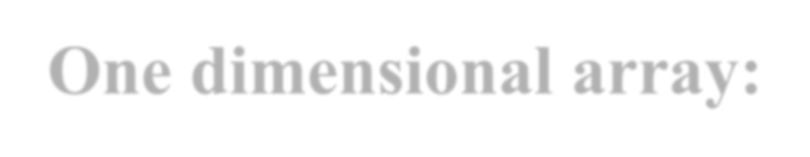

One dimensional array:
 An array with only one row or column is called one-dimensional array.
 It is finite collection of n number of elements of same type such that:
can be referred by indexing.
The syntax Elements are stored in continuous locations.
Elements x to define one-dimensional array is:
 Syntax: Datatype Array_Name [Size];
 Where,
Datatype : Type of value it can store (Example: int, char, float) Array_Name: To identify the array.
 Size : The maximum number of elements that the array can hold.

Slide 15


Arrays
 Simply, declaration of array is as follows: int arr[10]
 Where int specifies the data type or type of elements arrays stores.
 “arr” is the name of array & the number specified inside the square brackets is the number of elements an array can store, this is also called sized or length of array.

Slide 16

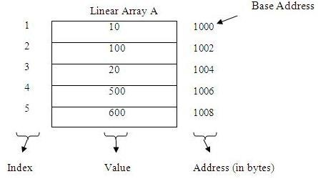
Represent a Linear Array in memory
 The elements of linear array are stored in consecutive memory locations. It is shown below:
15

Slide 17

Arrays
The elements of array will always be stored in the consecutive (continues) memory location.
The number of elements that can be stored in an array, that is the size of array or its length is given by the following equation:
(Upperbound-lowerbound)+1
For the above array it would be (9-0)+1=10,where 0 is the lower bound of array and 9 is the upper bound of array.
Array can always be read or written through loop.
For(i=0;i<=9;i++)
{ scanf(“%d”,&arr[i]);
printf(“%d”,arr[i]); }
16

Slide 18


Arrays types
 Single Dimension
Array
Array with one subscript
 Two Dimension Array
Array with two subscripts (Rows and Column)
 Multi Dimension Array
Array with Multiple subscripts

Slide 19

Basic operations of Arrays
 Some common operation performed on array are:
Traversing
Searching
Insertion
Deletion
Sorting
Merging

Slide 20

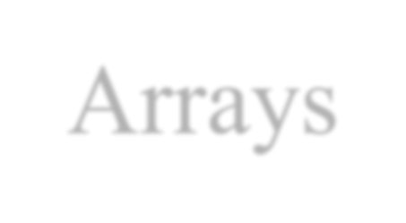
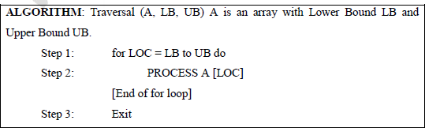
Traversing Arrays
 Traversing: It is used to access each data item exactly once so that it can be processed.
E.g.
We have linear array A as below:
 | 1 | 2 | 3 | 4 | 5
 | 10 | 20 | 30 | 40 | 50
Here we will start from beginning and will go till last element and during this process we will access value of each element exactly once as below:
A [1] = 10
A [2] = 20
A [3] = 30
A [4] = 40
A [5] = 50

Slide 21


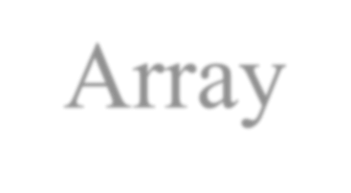
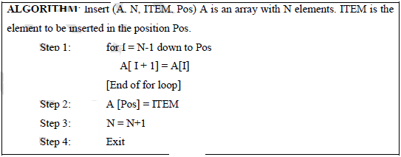
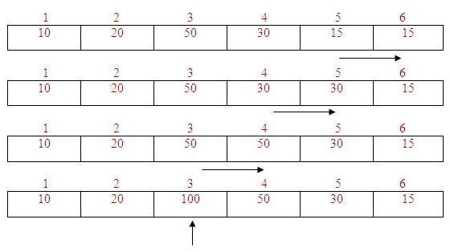
Insertion into Array
 Insertion: It is used to add a new data item in the given collection of data items.
E.g.We have linear array A as below:
1 | 2 | 3 | 4 | 5
10 | 20 | 50 | 30 | 15
New element to be inserted is 100 and location for insertion is 3. So shift the elements from 5th location to 3rd location downwards by 1 place.And then insert 100 at 3rd location. It is shown below:

Slide 22


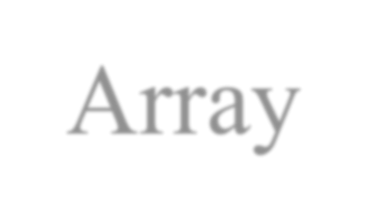
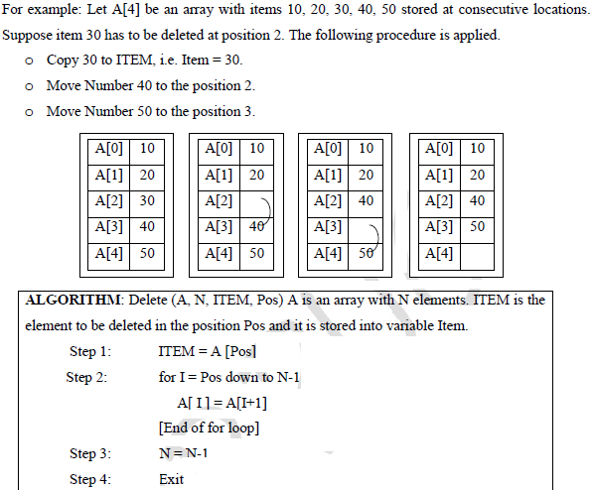
Deletion from Array
 Deletion: It is used to delete an existing data item from the given collection of data items.

Slide 23


Searching in Arrays
 Searching: It is used to find out the location of the data item if it exists in the given
collection of data items.
E.g. We have linear array A as below:
1 | 2 | 3 | 4 | 5
15 | 50 | 35 | 20 | 25
Suppose item to be searched is 20.We will start from beginning and will compare 20 with each element. This process will continue until element is found or array is finished.
Here:
Compare 20 with 15
20 # 15, go to next element.
Compare 20 with 50
20 # 50, go to next element.
Compare 20 with 35
20 #35, go to next element.
Compare 20 with 20
20 = 20, so 20 is found and its location is 4.

Slide 24

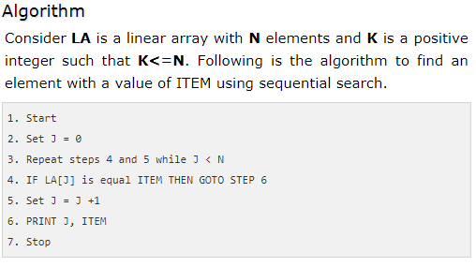
Linear Search
23

Slide 25

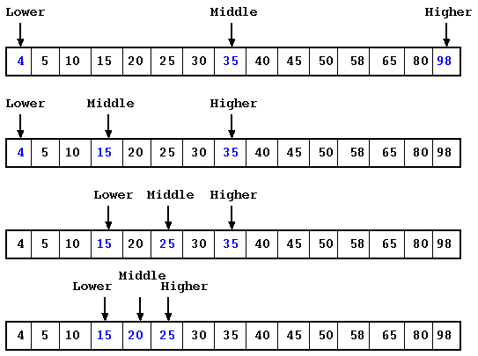
Binary Search
 The binary search algorithm can be used with only sorted list of elements.
 Binary Search first divides a large array into two smaller sub-arrays and then recursively operate the sub-arrays.
 Binary Search basically reduces the search space to half at each step

Slide 26
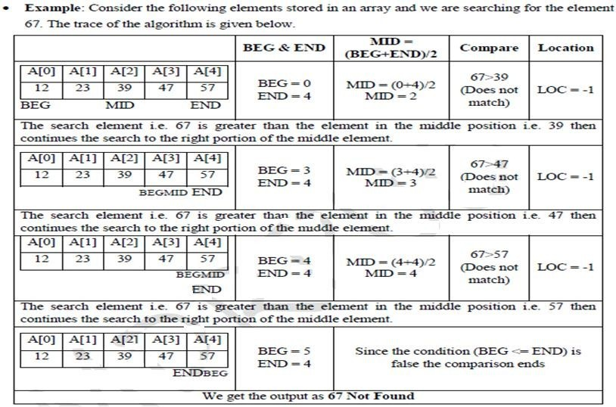
Binary Search

Slide 27
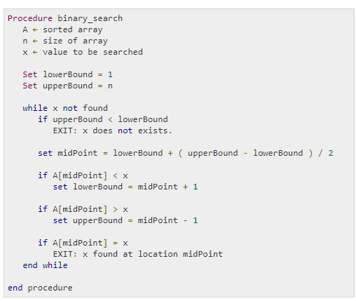
Binary Search

Slide 28

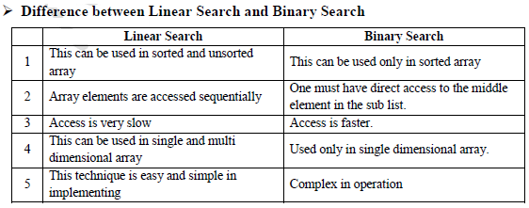
Searching

Slide 29

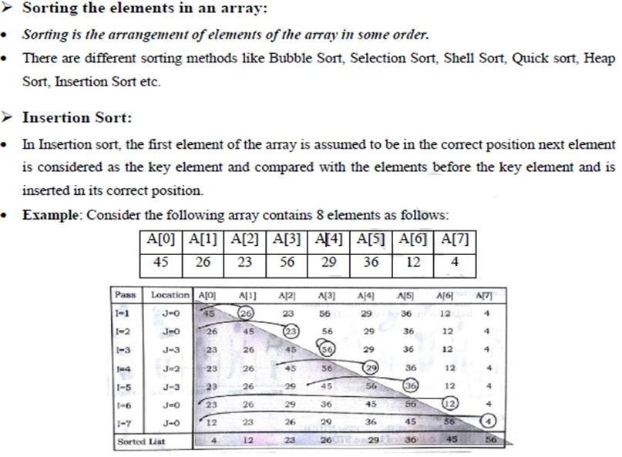
Sorting

Slide 30

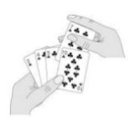
Insertion Sort
 ALGORITHM: Insertion Sort (A, N) A is an array with N unsorted elements.
Step 1: for I=1 to N-1
Step 2: J = I
While(J >= 1)
if ( A[J] < A[J-1] ) then
Temp = A[J]; A[J] = A[J-1]; A[J-1] =
Temp;
[End if]
J = J-1
[End of While loop] [End of For loop]
Step 3: Exit

Slide 31


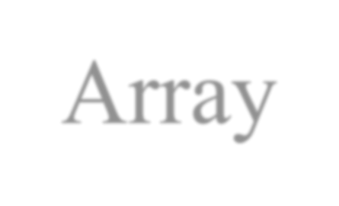
Merging from Array
 Merging: It is used to combine the data items of two sorted files into single file in the sorted form
We have sorted linear array A as below:
1 | 2 | 3 | 4 | 5 | 6
10 | 40 | 50 | 80 | 95 | 100
And sorted linear array B as below:
1 | 2 | 3 | 4
20 | 35 | 45 | 90
After merging merged array C is as below:
1 | 2 | 3 | 4 | 5 | 6 | 7 | 8 | 9 | 10
10 | 20 | 35 | 40 | 45 | 50 | 80 | 90 | 95 | 100
30

Slide 32
Two dimensional array
 A two dimensional array is a collection of elements and each element is identified by a pair of subscripts. ( A[3] [3] )
 The elements are stored in continuous memory locations.
 The elements of two-dimensional array as rows and columns.
 The number of rows and columns in a matrix is called as
the order of the matrix and denoted as mxn.
 The number of elements can be obtained by multiplying
number of rows and number of columns.
 | A[0] | A[1] | A[2]
A[0] | 10 | 20 | 30

Slide 33
A[1] | 40 | 50 | 60
A[2] | 70 | 80 | 90
31

Slide 34






Representation of Two Dimensional Array:
 A is the array of order m x n.To store m*n number of elements, we need m*n memory locations.
 The elements should be in contiguous memory locations.
 There are two methods: o Row-major method
o Column-major method

Slide 35
Two Dimensional Array:
 Row-Major Method: All the first-row elements are stored in sequential memory locations and then all the second-row elements are stored and so on. Ex: A[Row] [Col]
 Column-Major Method: All the first column elements are stored in sequential memory locations and then all the second- column elements are stored and so on. Ex: A [Col] [Row]
^{1000 10 A[0][0]} 1000 10 A[0][0]
^{1002 20 A[0][1]} 1002 40 A[1][0]
^{1004 30 A[0][2]} 1004 70 A[2][0]
1006 ⁴⁰ A[1][0] 1006 20 A[0][1]
1008 50 A[1][1] 1008 50 A[1][1]
1010 60 A[1][2] 1010 80 A[2][1]
1012 70 A[2][0] 1012 30 A[0][2]
_{1014 80 A[2][1]} 1014 60 A[1][2]
_{1016 90 A[2][2]} 1016 90 A[2][2]
Row-Major Method
Col-Major Method

Slide 36

Advantages of Array:
It is used to represent multiple data items of same type by using single name.
It can be used to implement other data structures like linked lists, stacks, queues, tree, graphs etc.
Two-dimensional arrays are used to represent matrices.
Many databases include one-dimensional arrays whose elements are records.

Slide 37



Disadvantages of Array
 We must know in advance the how many elements are to be stored in array.
 Array is static structure. It means that array is of fixed size. The memory which is allocated to array cannot be increased or decreased.
 Array is fixed size; if we allocate more memory than requirement then the memory space will be wasted.
 The elements of array are stored in consecutive memory locations. So insertion and deletion are very difficult and time consuming.
35

Slide 38

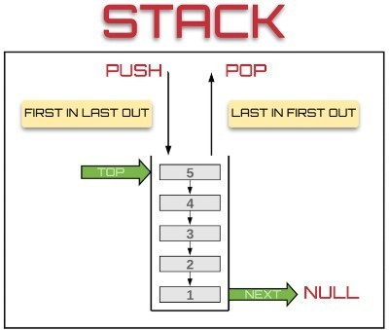
Stack
 Stack is a linear data structure which follows a particular order in which the operations are performed.
 Insertion of element into stack is called PUSH and deletion of element from stack is called POP.
 The order may be LIFO(Last In First Out) or FILO(First In Last Out).
36

Slide 39
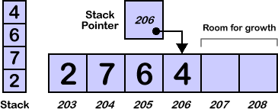

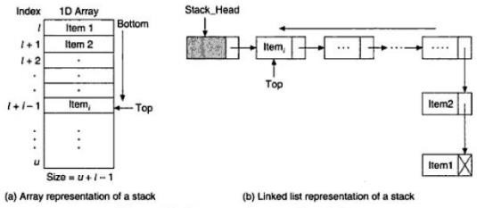
Representation of Stack in Memory
 The stack can be implemented into two ways:
Using arrays (Static implementation)
Using pointer (Dynamic implementation)
37

Slide 40

Operation on Stacks:
Stack( ): It creates a new stack that is empty. It needs no parameter and returns an empty stack.
push(item): It adds a new item to the top of the stack.
pop( ): It removes the top item from the stack.
peek( ): It returns the top item from the stack but does not remove it.
isEmpty( ): It tests whether the stack is empty.
size( ): It returns the number of items on the stack.

Slide 41

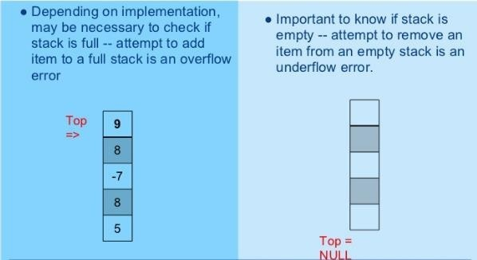
Stack Conditions

Slide 42

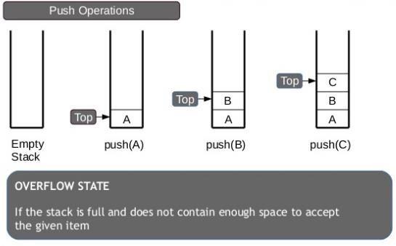
PUSH Operation
 The process of adding one element or item to the stack is represented by an operation called as the PUSH operation.

Slide 43

PUSH Operation:
 The process of adding one element or item to the stack is represented by an operation called as the PUSH operation.
 The new element is added at the topmost position of the stack.
ALGORITHM:
PUSH (STACK, TOP, SIZE, ITEM)
STACK is the array with N elements. TOP is the pointer to the top of the element of the array. ITEM to be inserted.
Step 1: if TOP = N then [Check Overflow]
PRINT “ STACK is Full or Overflow”
Exit
[End if]
Step 2: TOP = TOP + 1 [Increment the TOP] Step 3: STACK[TOP] = ITEM [Insert the ITEM] Step 4: Return

Slide 44

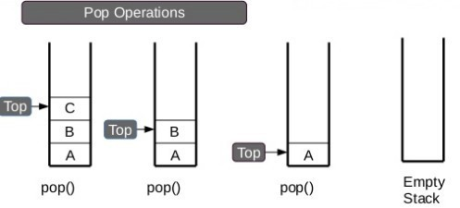
POP Operation
The process of deleting one element or item from the stack is represented by an operation called as the POP operation.
When elements are removed continuously from a stack, it shrinks at same end i.e., top

Slide 45
POP Operation
The process of deleting one element or item from the stack is represented by an operation called as the POP operation.
ALGORITHM: POP (STACK, TOP, ITEM)
STACK is the array with N elements. TOP is the pointer to the top of the element of the array. ITEM to be inserted.
Step 1: if TOP = 0 then [Check Underflow] PRINT “ STACK is Empty or Underflow”
Exit [End if]
Step 2: ITEM = STACK[TOP]
Element] Step 3: TOP = TOP - 1 Step 4: Return
[copy the TOP [Decrement the TOP]

Slide 46

PEEK Operation
The process of returning the top item from the stack but does not remove it called as the POP operation.
ALGORITHM: PEEK (STACK, TOP)
STACK is the array with N elements. TOP is the pointer to the top of the element of the array.
Step 1: if TOP = NULL then [Check Underflow]
PRINT “ STACK is Empty or Underflow”
Exit [End if]
Step 2: Return (STACK[TOP] [Return the top element of the stack]
Step 3:Exit
44

Slide 47

Application of Stacks
 It is used to reverse a word. You push a given word to stack
– letter by letter and then pop letter from the stack.


“Undo” mechanism in text editor.
Backtracking: This is a process when you need to
access the most recent data element in a series of elements. Once you reach a dead end, you must backtrack.
 Language Processing: Compiler’ syntax check for matching braces in implemented by using stack.
 Conversion of decimal number to binary.
 To solve tower of Hanoi.
 Conversion of infix expression into prefix and postfix.
 Quick sort
 Runtime memory management.

Slide 48

Arithmetic Expression
 An expression is a combination of operands and operators that after evaluation results in a single value.
Operand consists of constants and variables.
Operators consists of {, +, -, *, /, ), ] etc.
 Expression can be
Infix Expression: If an operator is in between two operands, it is called infix expression.
 Example: a + b, where a and b are operands and + is an operator.
Postfix Expression: If an operator follows the two operands, it is called postfix expression.
 Example: ab +
Prefix Expression: an operator precedes the two operands, it is called prefix expression.
 Example: +ab

Slide 49

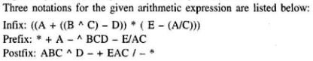
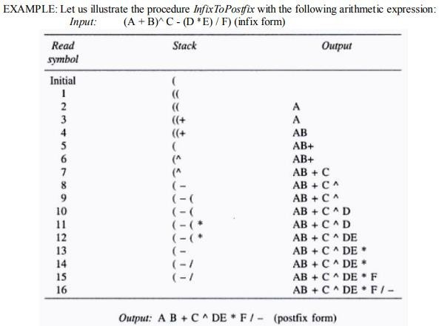
Arithmetic Expression

Slide 50

Queue
 A queue is an ordered collection of items where an item is inserted at one end called the “rear” and an existing item is removed at the other end, called the “front”.
 Queue is also called as FIFO list i.e. First-In First- Out.
 In the queue only two operations are allowed enqueue and dequeue.
 Enqueue means to insert an item into back of the queue.
 Dequeue means removing the front item.The people standing in a railway reservation row are an example of queue.

Slide 51

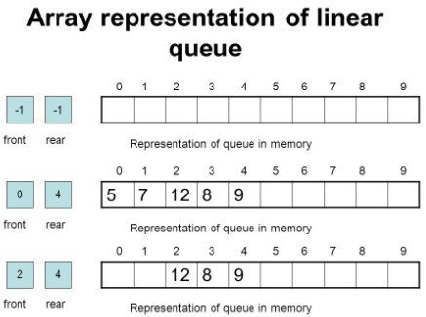
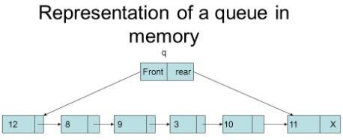
Queue
 The queue can be implemented into two ways:
Using arrays (Static implementation)
Using pointer (Dynamic implementation)
49

Slide 52

Types of Queues
 Queue can be of four types: o Simple Queue o Circular Queue
Priority Queue
De-queue ( Double Ended Queue)
50

Slide 53

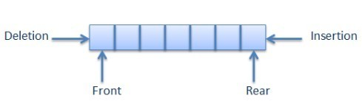
Simple Queue
 Simple Queue: In simple queue insertion occurs at the rear end of the list and deletion occurs at the front end of the list.
51

Slide 54

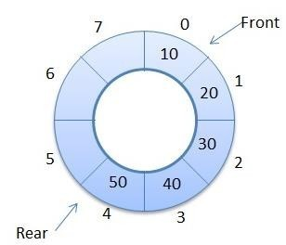
Circular Queue
 Circular Queue: A circular queue is a queue in which all nodes are treated as circular such that the last node follows the first node.

Slide 55

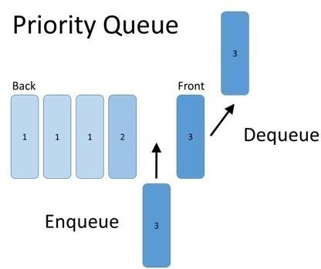
Priority Queue
 A priority queue is a queue that contains items that have some present priority. An element can be inserted or removed from any position depending upon some priority.
53

Slide 56

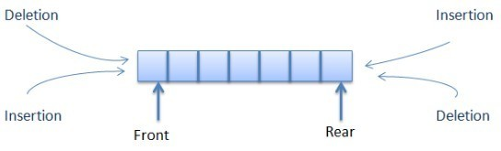
Dequeue Queue
 Dequeue: It is a queue in which insertion and deletion takes place at the both ends.

Slide 57

Operation on Queues
 Queue( ): It creates a new queue that is empty.
 enqueue(item): It adds a new item to the rear of the queue.
 dequeue( ): It removes the front item from the queue.
 isEmpty( ): It tests to see whether the queue is empty.
 size( ): It returns the number of items in the queue.

Slide 58


Memory Representation of a queue using array
 Queue is represented in memory using linear array.
 Let QUEUE is a array, two pointer variables called FRONT and REAR are maintained.
 The pointer variable FRONT contains the location of the element to be removed or deleted.
 The pointer variable REAR contains location of the last element inserted.
 The condition FRONT = NULL indicates that queue is empty.
 The condition REAR = N-1 indicates that queue is full.

Slide 59


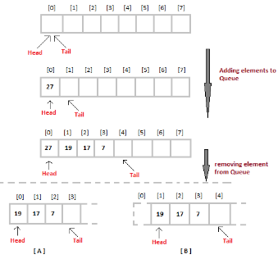
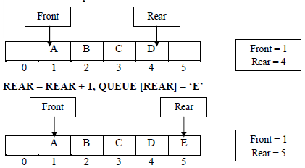
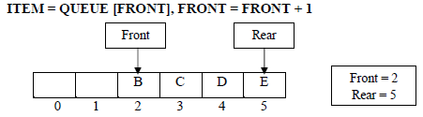
Memory Representation of a queue using array

Slide 60

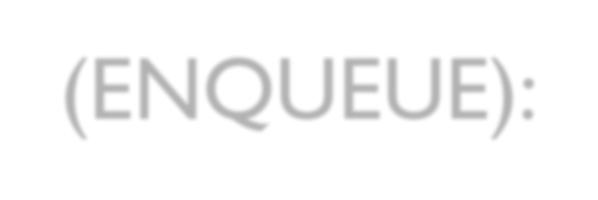
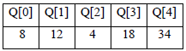
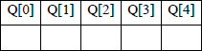
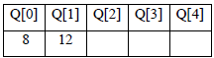
Queue Insertion Operation (ENQUEU
ALGORITHM: ENQUEUE (QUEUE, REAR, FRONT, ITEM)
QUEUE is the array with N elements. FRONT is the pointer that contains the location of the element to be deleted and REAR contains the location of the inserted element. ITEM is the element to be inserted.
Step 1: if REAR = N-1 then [Check Overflow] PRINT “QUEUE is Full or Overflow”
Exit [End if]
Step 2: if FRONT = NULL then [Check Whether Queue is empty] FRONT = -1
REAR = -1
else
REAR = REAR + 1 [Increment REAR Pointer]
Step 3: QUEUE[REAR] = ITEM [Copy ITEM to REAR position] Step 4: Return 58

Slide 61


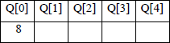
Queue Deletion Operation (DEQUE
ALGORITHM: DEQUEUE (QUEUE, REAR, FRONT, ITEM)
QUEUE is the array with N elements. FRONT is the pointer that contains the location of the element to be deleted and REAR contains the location of the inserted element. ITEM is the element to be inserted.
Step 1: if FRONT = NULL then [Check Whether Queue is empty] PRINT “QUEUE is Empty or Underflow”
Exit [End if]
Step 2: ITEM = QUEUE[FRONT]
Step 3: if FRONT = REAR then [if QUEUE has only one element] FRONT = NULL
REAR = NULL
else
FRONT = FRONT + 1 [Increment FRONT pointer] Step 4: Return

Slide 62

Application of Queue
 Simulation
 Various features of Operating system
 Multi-programming platform systems.
 Different types of scheduling algorithms
 Round robin technique algorithms
 Printer server routines
 Various application software’s is also based on queue data structure.

Slide 63

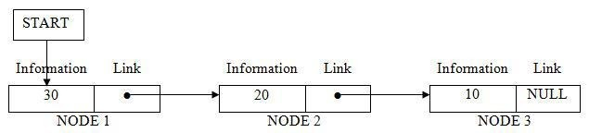
Lists
 A lists (Linear linked list) can be defined
as a collection of variable number of data items called nodes.
 Lists are the most commonly used
non- primitive data structures.
 Each nodes is divided into two parts:
The first part contains the information of the element.
o The second part contains the memory address of the next node in the list. Also called Link part.

Slide 64

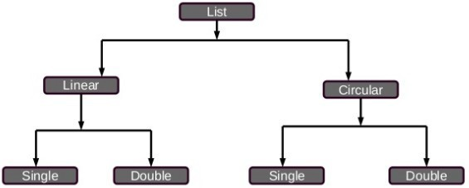
Lists
 Types of linked lists:
Single linked list
Doubly linked list
Single circular linked list
Doubly circular linked list

Slide 65
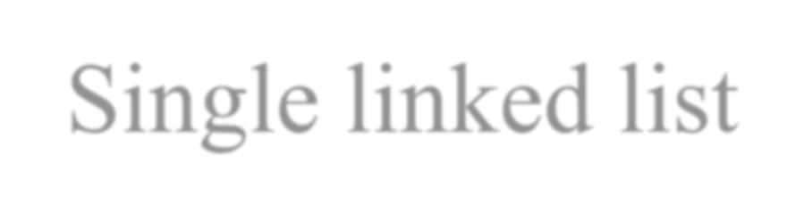
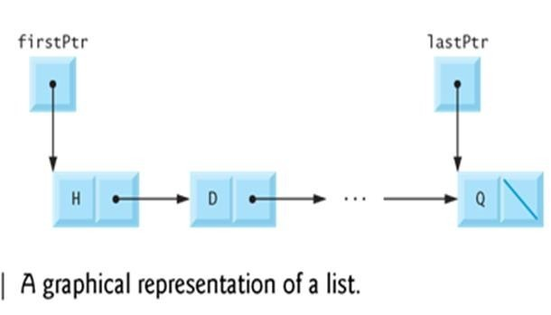
Single linked list
A singly linked list contains two fields in each node - an information field and the linked field.
The information field contains the data of that node.
The link field contains the memory address of the next node. There is only one link field in each node, the linked list is called singly linked list.

Slide 66
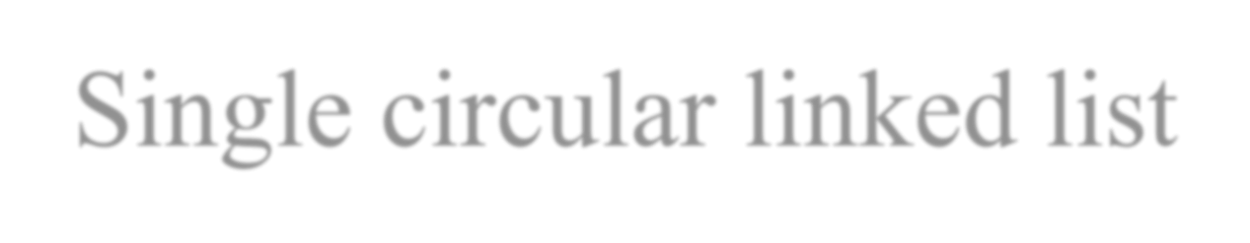
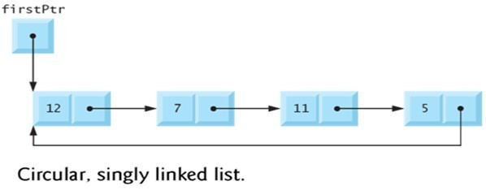
Single circular linked list
The link field of the last node contains the memory address of the first node, such a linked list is called circular linked list.
In a circular linked list every node is accessible from a given node.

Slide 67

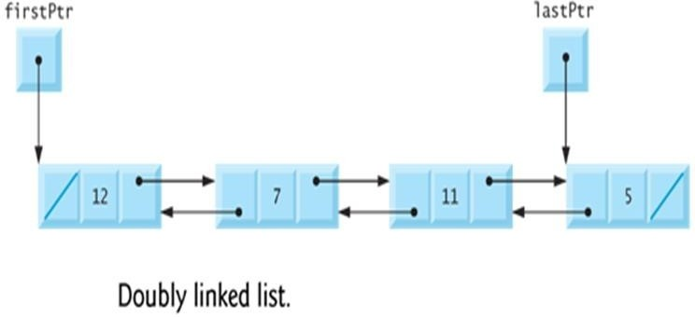
Doubly linked list
It is a linked list in which each node is points both to the next node and also to the previous node.
In doubly linked list each node contains three parts:
FORW : It is a pointer field that contains the address of the next node
BACK: It is a pointer field that contains the address of the previous node.
INFO: It contains the actual data.
In the first node, if BACK contains NULL, it indicated that it is the first node in the list.
 The node in which FORW contains, NULL indicates that the node is the last node.

Slide 68
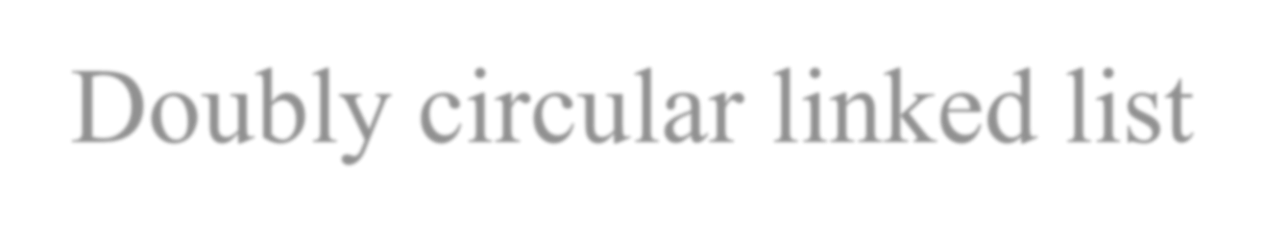
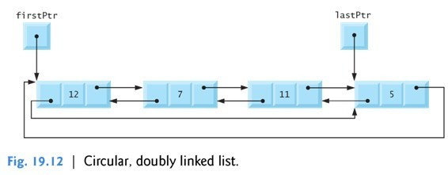
Doubly circular linked list

Slide 69

Operation on Linked List
 The operation that are performed on linked lists are:
Creating a linked list
Traversing a linked list
Inserting an item into a linked list.
Deleting an item from the linked list.
Searching an item in the linked list
Merging two or more linked lists.

Slide 70

Creating a linked list
 The nodes of a linked list can be created by the following structure declaration.
struct Node
{
int info;
struct Node *link;
}*node1, node2;
 Here info is the information field and link is the link field.
 The link field contains a pointer variable that refers the same node structure. Such a reference is called as Self addressing pointer.

Slide 71

Operator new and delete
 Operators new allocate memory space.
Operators new [ ] allocates memory space for array.
 Operators delete deallocate memory space.
Operators delete [ ] deallocate memory space for array.

Slide 72

Traversing a linked list:
 Traversing is the process of accessing each node of the linked list exactly once to perform some operation.
 ALGORITHM: TRAVERS (START, P) START contains
the address of the first node. Another pointer p is temporarily used to visit all the nodes from the beginning to the end of the linked list.
Step 1: P = START
Step 2: while P != NULL
Step 3:
Step 4:
PROCESS data (P)
P = link(P)
[Fetch the data] [Advance P to next
node] Step 5: End of while Step 6: Return
70

Slide 73


Inserting a node into the linked
 Inserting a node at the beginning of the linked list
 Inserting a node at the given position.
 Inserting a node at the end of the linked list.

Slide 74


Inserting node at Front
Inserting a node at the beginning of the linked list
Create a node.
Fill data into the data field of the new node.
Mark its pointer field as NULL
Attach this newly created node to START
Make the new node as the START node.
72

Slide 75

Inserting node at Front
 ALGORITHM: INS_BEG (START, P)
START contains the address of the first node.
Step 1: P new Node;
Step 2: data(P)
Step 3: link(P)
Step 4: START
Step 5: Return
num; START P
73

Slide 76


Inserting node at Last

Slide 77

Inserting node at Last
 ALGORITHM: INS_END (START, P) START contains
the address of the first node.
Step 1: START
Step 2: P START [identify the last node] while P!= null
P next (P) End while
Step 3: N new Node; Step 4: data(N) item; Step 5: link(N) null Step 6: link(P) N Step 7: Return

Slide 78
Inserting node at a given Position
ALGORITHM: INS_POS (START, P) START contains the
address of the first node.
Step 1: START
else if (POS<=Count) P Start
For(i=1; i<=pos; i++)
Step 2: P START [Initialize node]
Count 0
Step 3: while P!= null
count P
End while Step 4: if (POS=1)
P next(P); end for
count+1 next (P)
[create] N data(N) link(N) link(P) else
new node item; link(P)
N
Call function INS_BEG( ) else if (POS=Count +1) Call function INS_END( )
PRINT “Invalid position” Step 5: Return

Slide 79


Deleting an node
 Deleting an item from the linked list:
Deletion of the first node
Deletion of the last node
Deletion of the node at the give position

Slide 80

Deleting node from end
ALGORITHM: DEL_END (P1, P2, START) This used two
pointers P1 and P2. Pointer P2 is used to traverse the linked list and pointer P1 keeps the location of the previous node of P2.
Step 1: START
Step 2: P2 START;
Step 3: while ( link(P2) ! = NULL) P1 P2
P2 link(P2) While end
Step 4: PRINT data(p2)
Step 5: link(P1)
Free(P2) Step 6: STOP
NULL

Slide 81


Deleting node from end

Slide 82



Non-Linear Data structures
A Non-Linear Data structures is a data structure in which data item is connected to several other data items.
The data items in non-linear data structure represent hierarchical relationship.
Each data item is called node.
The different non-linear data structures are
Trees
Graphs.

Slide 83


Trees
A tree is a data structure consisting of nodes organized as a hierarchy.
Tree is a hierarchical data structure which stores the information naturally in the form of hierarchy style.
It is a non-linear data structure compared to arrays, linked lists, stack and queue.
It represents the nodes connected by edges.

Slide 84




Terminology of a Tree

Slide 85



Binary Tree
 A binary tree is an ordered tree in which each internal node can have maximum of two child nodes connected to it.
 A binary tree consists of:
A node ( called the root node)
Left and right sub trees.
 A Complete binary tree is a binary tree in which each leaf is at the same
 distance from the root i.e. all the nodes have maximum two subtrees.
Binary tree using array represents a node which is numbered sequentially level by level from left to right. Even empty nodes are numbered.

Slide 86

Graph
 Graph is a mathematical non-linear data structure capable of representing many kind of physical structures.
A graph is a set of vertices and edges which connect them.
 A graph is a collection of nodes called vertices and the connection between them called edges.
 Definition: A graph G(V,E) is a set of vertices V and a set of edges E.

Slide 87
Graph
 An edge connects a pair of vertices and many have weight such as length, cost and another measuring instrument for according the graph.
 Vertices on the graph are shown as point or circles and edges are drawn as arcs or line segment.
86

Slide 88


Thank you
88

